Slide 1
STAFFING
Staffing or HRM is defined as filling, and keeping filled positions in the organization structure so that competent people are available at the right time to achieve organizational objectives.
Includes the following activities:
Manpower planning: involves job analysis, job description, and job evaluation; determining of the man power requirements and inventorying the people available.
Recruiting
Selecting

Slide 2
CONTINUE….
3.Training or developing the Candidates
4. Placing
5.Orienting
6.Promoting
7. Appraising
8. Planning the careers
9. Compensating
10. Labour relations
11.HR records and research

Slide 3
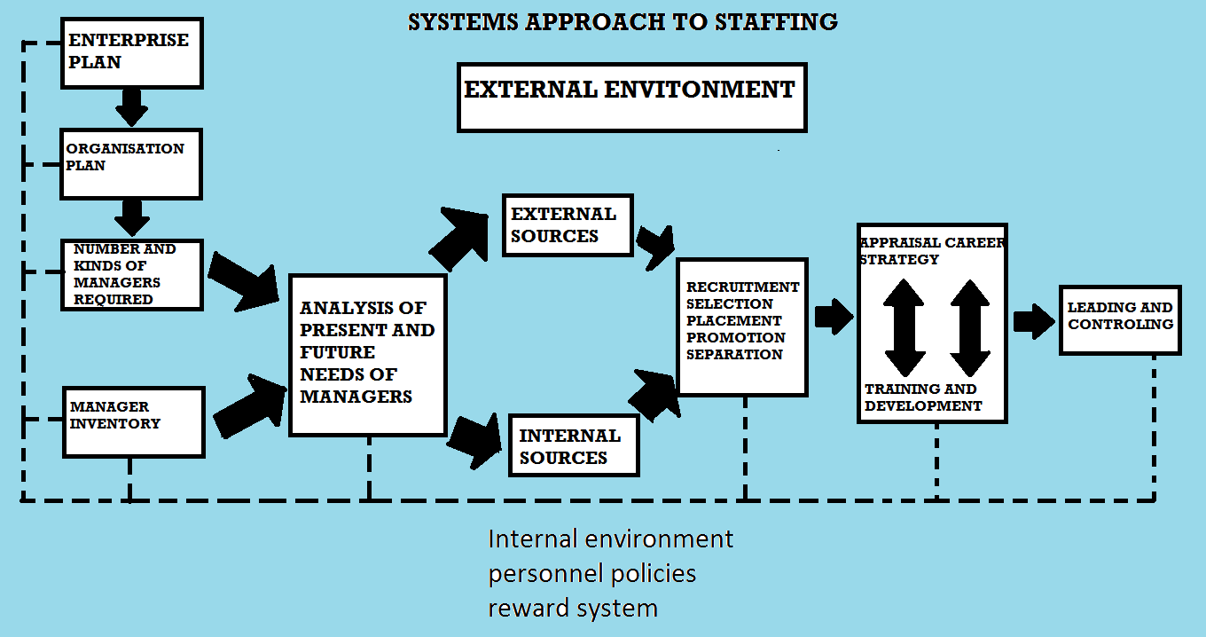

Slide 4
Systems approach to HRM (Staffing)
Enterprise plans become the basis for organization plans to achieve enterprise objectives.
Present and projected organization structure determines the number and kinds of managers required.
The demands for Managers are compared with available talent through the management inventory.
Well trained managers create an environment in which people together in groups, can achieve enterprise objectives and at the same accomplish personal goals.
Staffing requires an open- system approach.

Slide 5
Continue….
It is linked to the external environment and internal factors of the firm such as personnel policies, the organizational climate, and the reward systems.
The external environment includes factors such as - high technology demands for well – trained, well educated, and highly skilled managers.

Slide 6
Factors Affecting the number and kinds of Managers Required
Depends not only upon its size but also upon the complexity of the organization structure, the plans for expansion and the rate of turnover of personnel.
It is possible by enlarging or contracting the delegation of authority to modify a structure so that the number of managers in a given instance will increase or decrease regardless of the size of an operation.

Slide 7
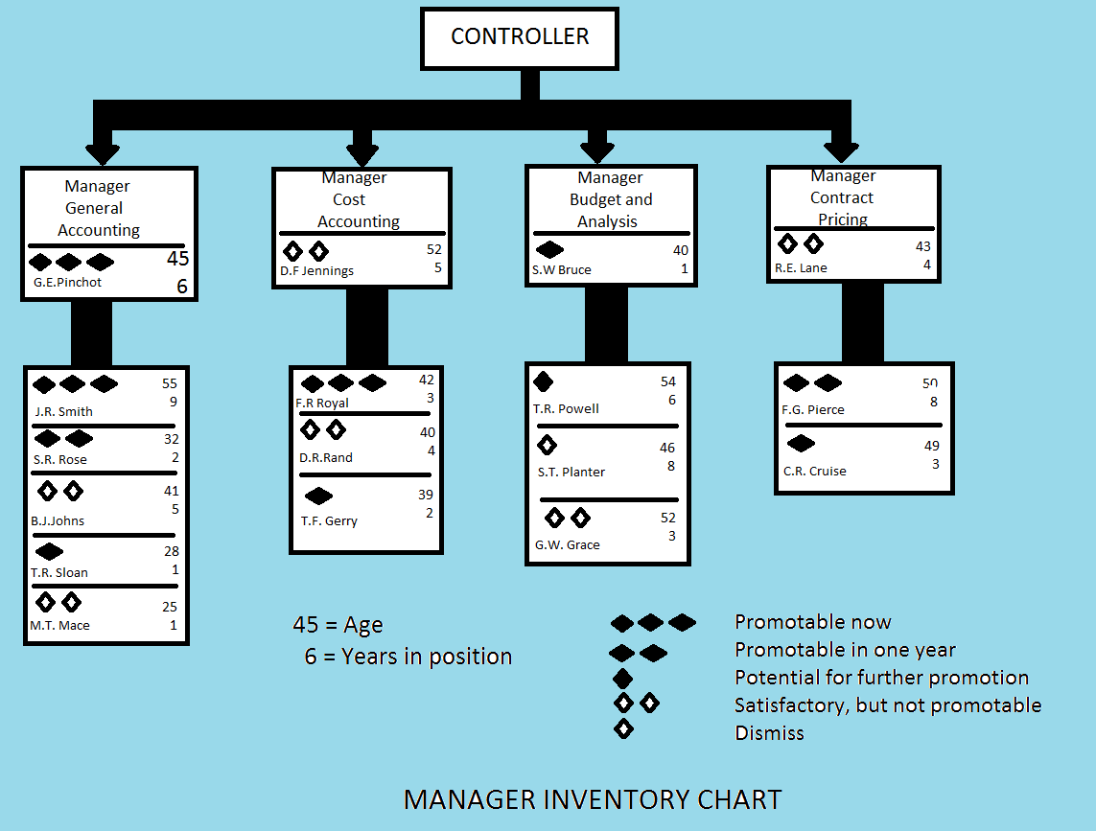

Slide 8
Determination of Available Managerial Resources
Management potential within a firm can be done by the use of an inventory chart.
It is simply an organization chart of a unit with managerial positions indicated and keyed as to the promotability of each incumbent.
At a glance the controller can see where he or she stands with respect to the staffing function.
The controller’s successor is the manager of general accounting person in turn has a successor ready for promotion .

Slide 9
Continue…..
Cost accounting manager represents the case of a person who is acceptable but not promotable.
The manager of budget and analysis has considerable development to accomplish before being ready for promotion.
Contract pricing portends some problems.
The manager is not promotable but there is good potential in the subordinates.

Slide 10
ORIENTING AND SOCIALIZING NEW EMPLOYEES
Orientation involves the introductions of new employees to the enterprise, its functions, tasks, and people.
Large firms have a formal orientation program which explains these features of the company history, products, services, general policies and practices.
It also includes organizational benefits, insurance,retirement,vacations, requirements for confidentiality and secrecy, safety and other regulations.

Slide 11
MANAGER DEVELOPMENT PROCESS AND TRAINING
Organization development is a systematic, integrated and planned approach to improving the effectiveness of groups of people and of the whole organization.
Manager development refers to the progress a person makes learning how to manage.
Manager development concentrates on individuals.
Managerial training, pertains to the programs that facilitate the learning process

Slide 12
steps in manager development
1. Present Job
Manager development and training must be based on a needs analysis derived from a comparison of actual performance and behavior with required performance and behavior.
Example: A district sales manager has decided that the selling of 1000 units is a reasonable expectation, actual sales are only 800, 200 units short of the sales target.
Analysis indicate that the manager lacks knowledge and skills and that conflicts among subordinate managers hinder effective teamwork.
On the basis of this analysis, training needs and methods for overcoming the deficiencies are identified.

Slide 13
CONTINUE….
2.Next job: Similar process is applied in the identification of the training needs for the next job.
Specifically present competency is compared with the competency demanded by the next job.
3.Future Needs: In this approach they prepare for the more distant future.
This requires that they forecast what new competencies will be demanded by changing technology and methods.
Example: Energy shortages may occur, and this requires that managers be trained not only in the technical aspects of energy conservation but also in energy- related long range planning and creative problem solving.

Slide 14
APPROACHES TO ON THE JOB TRAINING
1. Planned Progression:
Is a technique that gives managers a clear idea of their path of development.
Managers know where they stand and where they are going.
Example: a lower level manager may have available an outline path from: superintendent to works manager,
Again, eventually to production manager may be perceived by trainees as a smooth path to the top.
It is a step-by- step approach which requires that tasks be done well at each level.

Slide 15
Continue….
2. Job Rotation: The purpose is to broaden the knowledge of managers or potential managers.
Trainees learn about the different enterprises functions by rotating into different positions.
They may rotate through:
Nonsupervisory work
Observation assignments (observing what managers do rather than managing themselves)
Various managerial training positions
Middle- level assistant position

Slide 16
Continue…..
5. Unspecified rotation to various managerial positions in different departments such as production, sales, and finance.
Drawbacks:
In some job rotation programs, participants do not actually have managerial authority they assist line managers.
They do not have the responsibility as they would have if they were actually managing.
3. Creation of Assistant-to positions
Assistant to positions are frequently created to broaden the viewpoints of trainees by allowing them to work closely with experienced managers.

Slide 17
CONTINUE….
Experienced managers can give special attention to the developmental needs of trainees.
Give selected assignments to test the judgments of trainees.
4. Temporary Promotions: Individuals are appointed as acting managers, when:
Example: when permanent manager is on vacation, ill or is making an extended temporary promotion.
Are a developmental device as well as convenience to the enterprise.
Makes decisions and assumes full responsibility, the experience can be valuable.

Slide 18
Continue….
5. Committees and junior Boards
Are also known as multiple management and are used as developmental techniques.
Give trainees the opportunity to interact with experienced managers, trainees from the middle, but sometimes from the lower level also.
They learn about the relationships among different departments and the problems created by the interaction.
Trainees may get the opportunity to submit reports and proposals to the committee.

Slide 19
CONTINUE…..
6. Coaching
To be effective is the responsibility of every line manager.
Coaching requires time but if done well it will save time and money and will prevent costly mistakes by subordinates.
It will benefit all-- the superior, the subordinates and the enterprise.
Example of on the job- training is:
athletic coaching.

Slide 20
APPROACHES TO MANAGER DEVELOPMENT INTERNAL AND EXTERNAL TRAINING
These programs may be conducted within the company or they may be offered externally.
1.Sensitivitytraining,T-group,and Encounter Groups:
T- stands for training, encounter group or leadership training is a controversial approach to manager development.
The objectives of sensitivity training generally include:
Better insight into one’s own behavior and the way one appears to others.
Better understanding of group processes

Slide 21
CONTINUE…
3. Development of skills in diagnosing and intervening in group processes.
4. people interact and then receive feedback on their behavior from the trainer and other group members, who express their opinions freely and openly.
Guidelines that can help to reduce potential harm and increase effectiveness:
1. Participation in T- groups should be made voluntary
2. Participants should be screened, those who could be harmed should be excluded from this experience
3.Trainers should be carefully evaluated and their competence clearly established

Slide 22
Continue…..
4. Participants should be informed about the goals and process before they commit themselves to sensitivity training.
5.Before using, organizations should clearly identify development and training needs and objectives.
Conference Programs:
May be used in internal or external training.
During programs, potential managers are exposed to the ideas of speakers who are experts in their field.
People may be instructed in history of the firm and its purposes, policies, relationships with customers, consumers, and other groups.

Slide 23
Continue…..
External conference may range from programs on specific managerial techniques to programs on broad topics, such as the relationship between business and society.
Conferences can be made more successful by including discussions; two- way communication etc,.
University Management Programs
Universities now conduct courses, workshops, conferences, institutes and formal programs for training managers.

Slide 24
CONTINUE……
These include: evening courses, short seminars, live- in programs, a full graduate curriculum.
Also programs that are custom- designed for the needs of individual companies.
Reading:
Another approach is planned reading of relevant and current management literature.
This can be enhanced through discussion of articles and books with other managers and the superior.

Slide 25
CONTINUE…..
Business Simulation, Experiential Exercises and Expert Systems:
Expert systems involves the use of computers to duplicate the functioning of the brain.
Example: Are used:
for checking sales order
for oil drilling, for monitoring steam turbines at Westinghouse
for credit authorization at American Express for tax accounting decisions
for pricing systems bids at IBM and for capital investments at Texas Instruments.

Slide 26
Continue…..
Special Training Programs
Training programs specifically designed for members of minority groups and for individuals who are physically handicapped.
Training Evaluation and Transfer involves:
Determining the effectiveness of training programs.
It requires measurements against standards and a systematic identification of training and objectives.
Developmental objectives include:
1 An increase in knowledge
2. Development of attitudes conducive to good managing
3. Acquisition of skills
4. Improvement of management performance
5. Achievement of enterprise objectives.

